Slide 1
How to get Your Students to Drive your Technological Classroom
Fasten Your Seatbelts!!!!!!

Slide 2
The Setting
Equipment: Promethean Board
            Mobile Device Android for this Presentation
            Cooperative Students(sometimes in short supply)

Slide 3
Setup ActivCast on Your Tablet/Mobile
Go to Google Play Store
Search for ActivCast Sender for Promethean
Make sure you have version 4.3
Install
Raise your hand if you run into Trouble
Signify complete by placing your device on the table
Breathe, the hard part is over!!

Slide 4
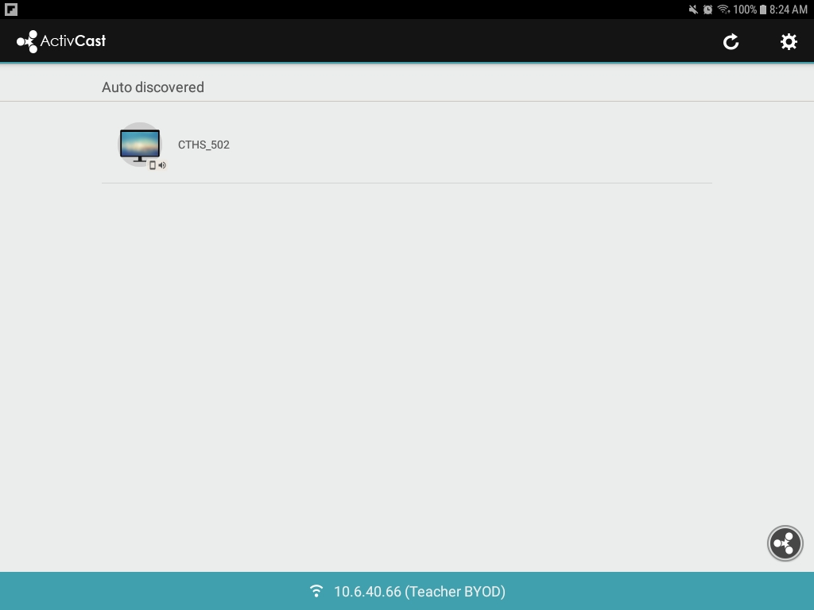
Start ActiveCast, Raise your hand If you don’t see this:

Slide 5
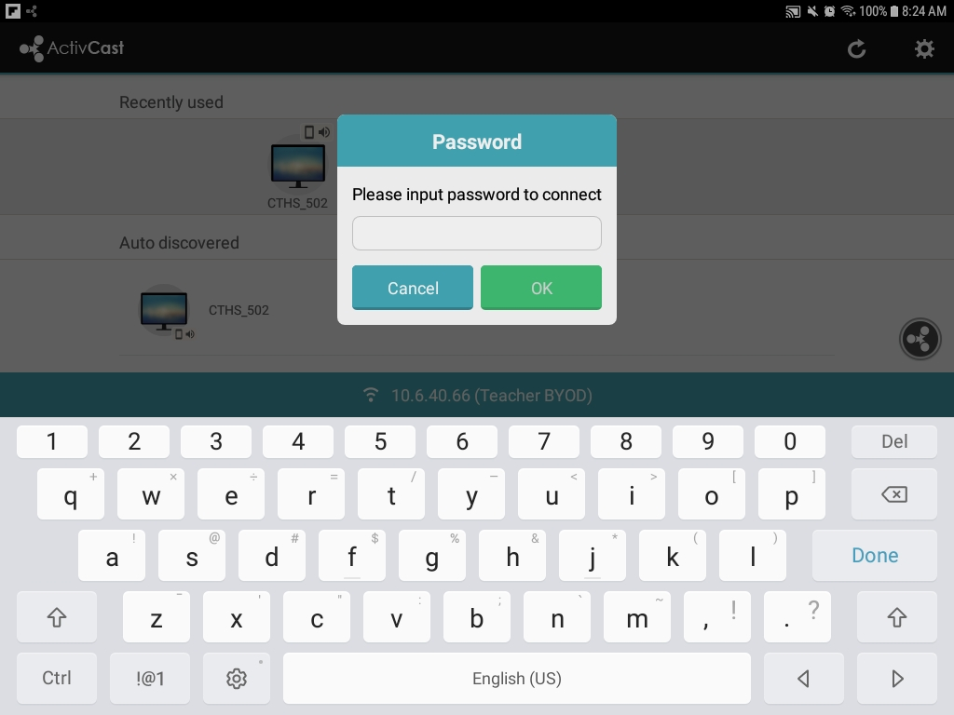
Select CTHS 502 and you will see:

Slide 6
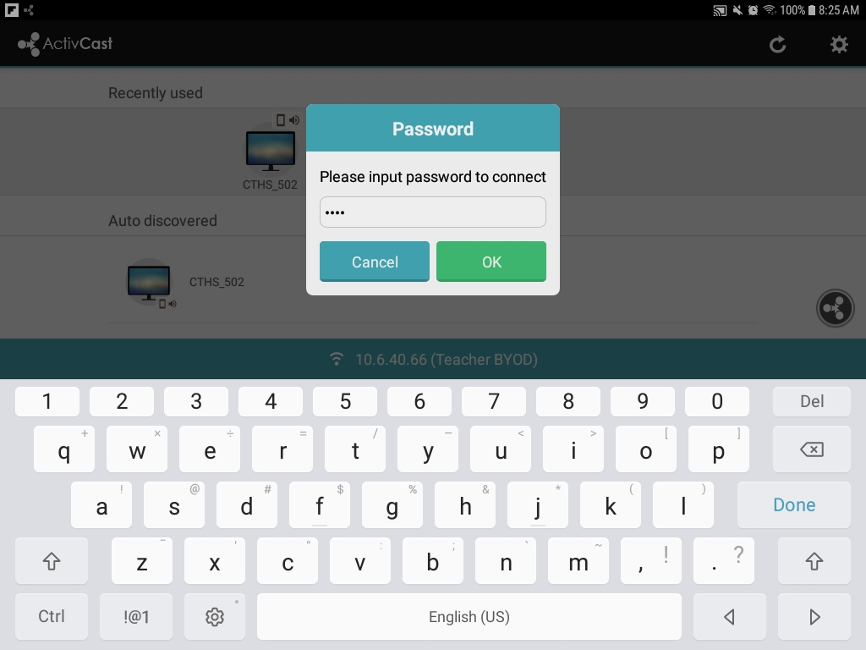
Don’t Enter the Code Yet, but this is what is next:

Slide 7
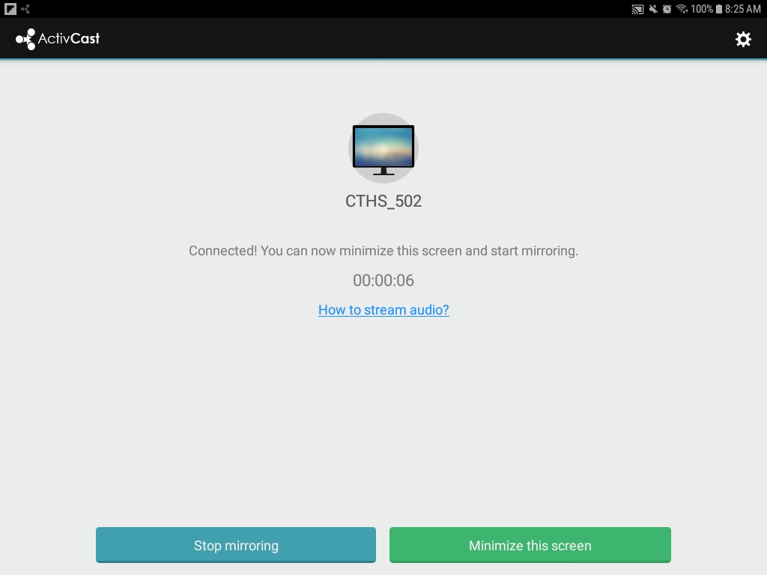
This is what you see when you are connected:

Slide 8
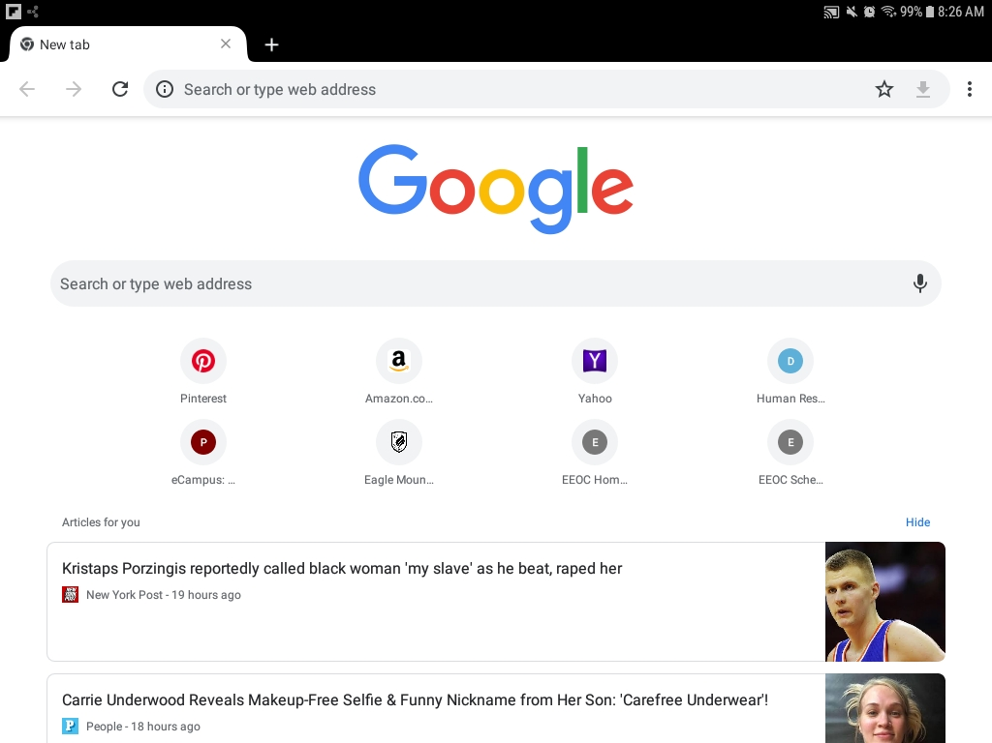
Now you would Navigate to your content:

Slide 9
You try it Now
Table 1 first type in the Code and Connect
Verify Connection
Navigate to Chrome
Disconnect
Table 2 next and so on….

Slide 10
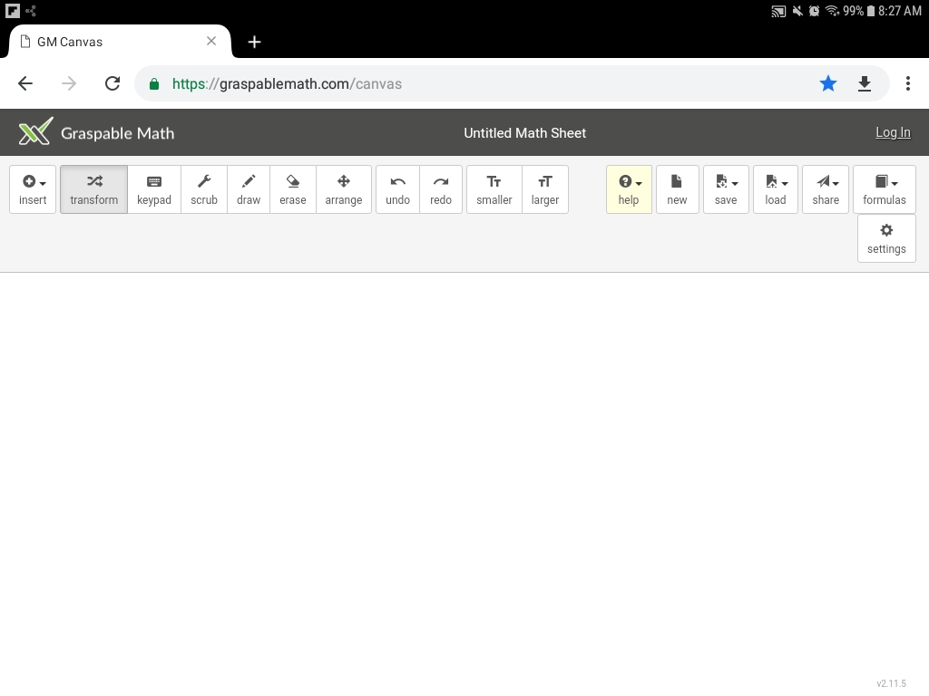
Alright! Nice Job! Let’s See Some content:
Graspable math
  On your Device Go to www.graspablemath.com/canvas

Slide 11
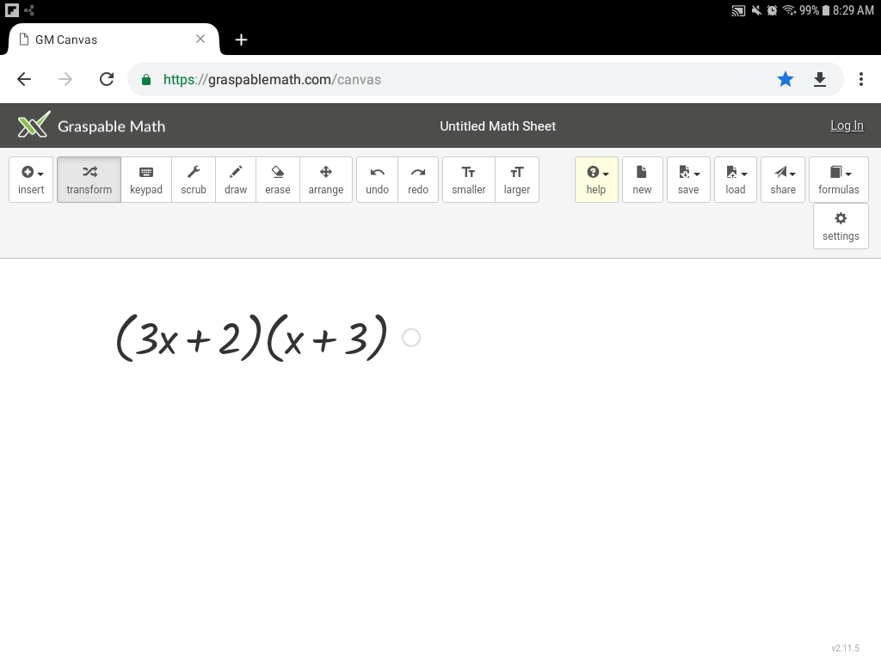
Graspablemath:

Slide 12
The Downside
(The rest of the Story)
Students can get into areas where they shouldn’t be, no surprise!
Setup a user on your device that limits access to very little
This is done in setup/Cloud and Accounts/users
Raise your hand if you need help to create a guest profile.
Hover when they have your device!

Slide 13
Are you ready?
Content should be setup on your mobile device
ActivCast is on your device
Promethean board is fully configured
Student expectations are well defined
Device is fully charged
And your Seatbelts are fastened!
Engage Hyper-learning!

Slide 14
Legal
Use district approved content!!!
They make sure all licenses and copyrights are good.
And we have some pretty talented folks finding us goodies.

